Slide 1
Projet CPS (MI047)
River City Ransom
Kevin Coquart
Quentin Bunel

Slide 2
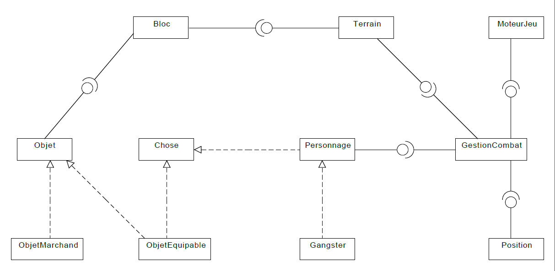

Slide 3
Gestion Combat
Position
Personnage
mPerso
mPos
String
mFG
Etat

Slide 4

Implémentation

